Slide 1
CHAPTER 3
Transaction management

Slide 2
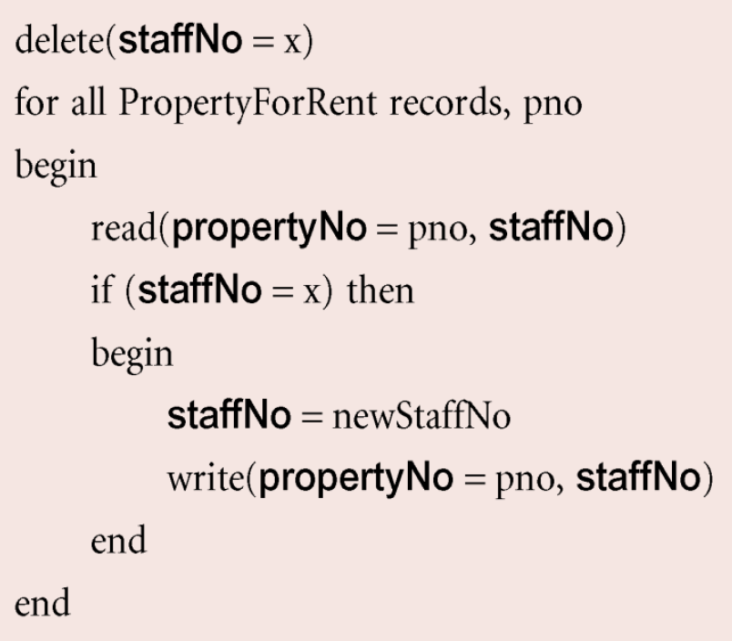
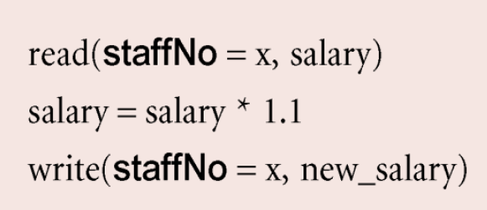
Transaction
A database transaction is a unit of work which is made up of one or multiple operations.
It is treated as a whole.
Transaction 1
Transaction 2
Notes:
Operations -> read, write

Slide 3
Transaction
All operations will happen, or nothing happen.
Transactions in a database environment have three main purposes
To provide reliable units of work that allow recovery from failures
To keep a database consistent even in cases of system failure.
To provide isolation between programs accessing a database concurrently.
Notes:
Operations -> read, write

Slide 4
Properties of transactions
Properties of database transactions (ACID) consist of
Atomicity
Consistency
Isolation
Durability
All transactions must satisfy the ACID properties.

Slide 5
Properties of transactions
Atomicity
A transaction composed of multiple statements is treated as single unit.
A transaction must be fully complete, committed or rolled back.
Consistency
Any data written to the database must be valid according to all defined rules.
A transaction transforms database from one consistent state to another consistent state.
Notes:
Constraints →
UNIQUE, NOT NULL, PRIMARY KEY, FOREIGN KEY, CHECK
-----
cascades, triggers

Slide 6
Properties of transactions
Isolation
Transaction data must NOT be available to other transactions until the original transaction is committed or rolled back.
The effects of an incomplete transaction might NOT be visible to other transactions.
Durability
Once a transaction has been committed and data has written on the database, that data will remain in database even in the case of a system failure

Slide 7
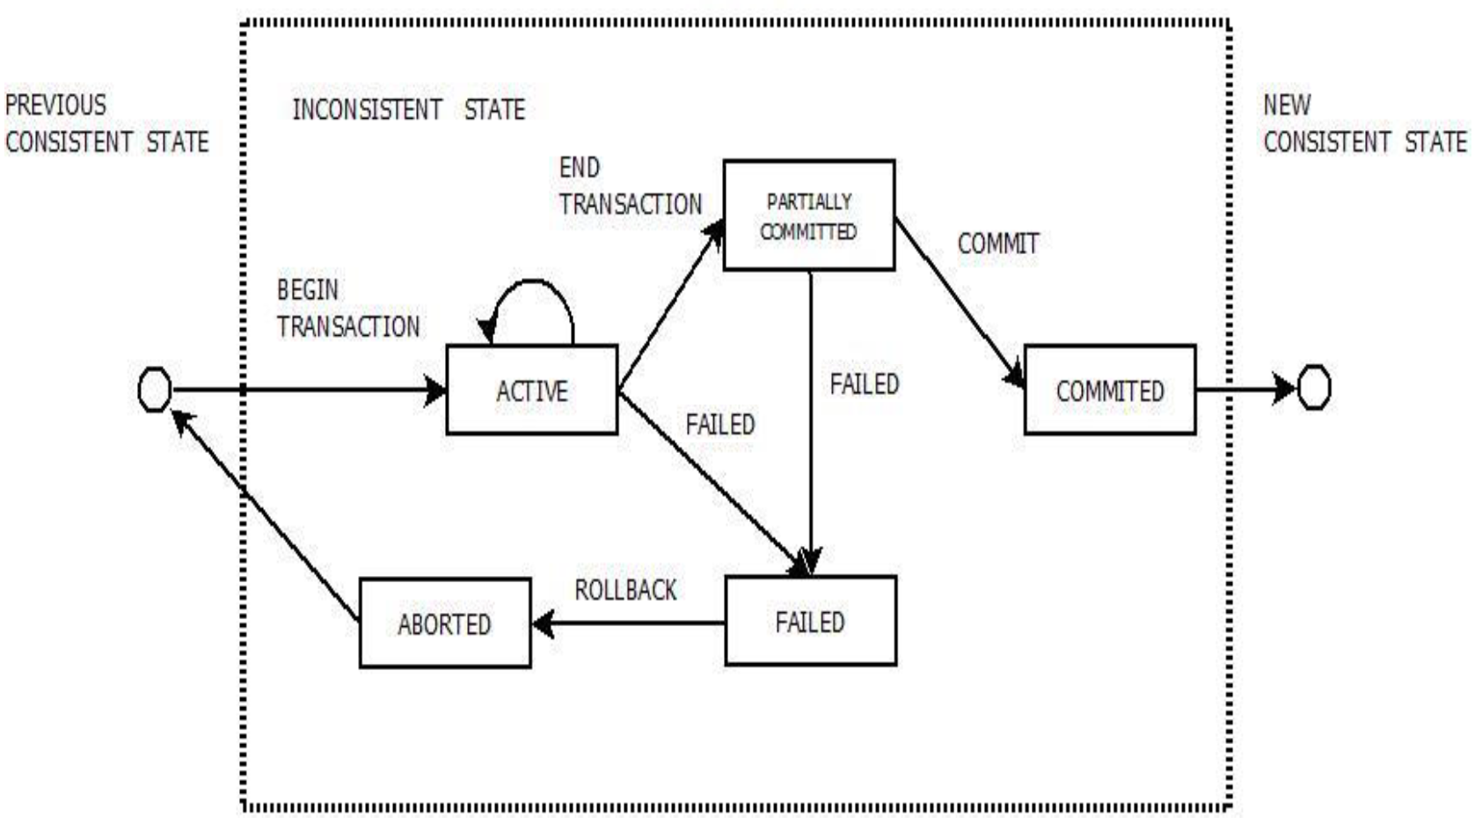
Transaction state diagram

Slide 8
Transaction state diagram
Active State
A transaction is called in an active state as long as its instructions are getting executed.
All the changes made by the transaction now are stored in main memory.
Partially Committed State
After the last instruction of transaction has executed, it enters into a partially committed state.
It is not considered fully committed because all the changes are not stored on disk.
Committed State
All the changes made by the transaction have been successfully stored on disk.
Now, the database is in a new consistent state.
It is NOT possible to undo the changes that has been made by the transaction.

Slide 9
Transaction state diagram
Failed State
When a transaction is getting executed in the active state or partially committed state and some failure occurs due to which it becomes impossible to continue the execution, it enters into a failed state.
Aborted State
After the transaction has failed and entered a failed state, all the changes made by it must be undone.
When all changes are rolled back, the database goes back to the previous consistent state.

Slide 10
DBMS’ functions related to transaction
Concurrency control
To maximize concurrent transactions without interfere with each other.
Database recovery
To ensure durability and consistency of database even though a failure occurs during transaction.
Notes:
9.15

Slide 11
Concurrency control
Concurrency control is the procedure in DBMS for managing simultaneous operations without conflicting with each another.
It makes sure that database transactions are performed concurrently without violating the data integrity of respective databases.
It is used to address such conflicts that mostly occur in a multi-user system.
It is an important element when two or more transactions request to access the same data, simultaneously.
If all users just read data. There is no interfere with one another.

Slide 12
Problems in concurrency
Two or more concurrent transactions may cause the following problems.
Lost update problem
Uncommitted dependency problem
Non-repeatable read problem
Inconsistent analysis problem
Phantom read problem

Slide 13
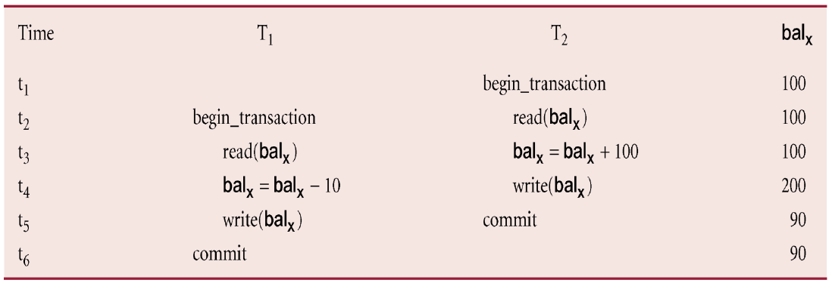
Lost update problem
A completed update operation by one transaction is overridden by another transaction.

Slide 14
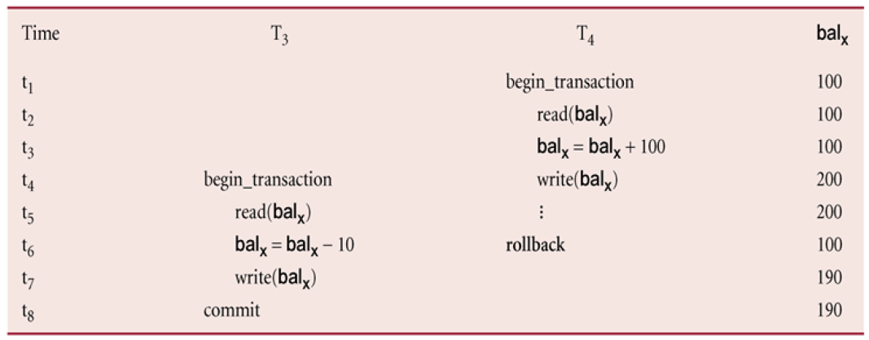
Uncommitted dependency problem
A transaction can see the intermediate results of another transaction before it has committed.

Slide 15
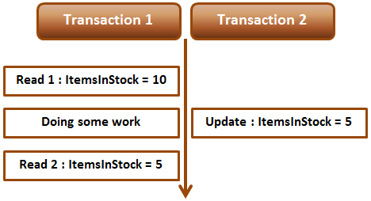
Non-repeatable read (fuzzy read) problem
A transaction rereads a data item that it has previously read, but (in between) another transaction has modified it.

Slide 16
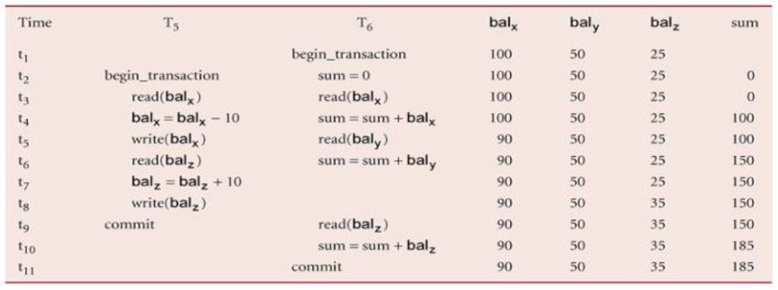
Inconsistent analysis problem
A transaction reads several values from database but a second transaction updates some of them during the execution.

Slide 17
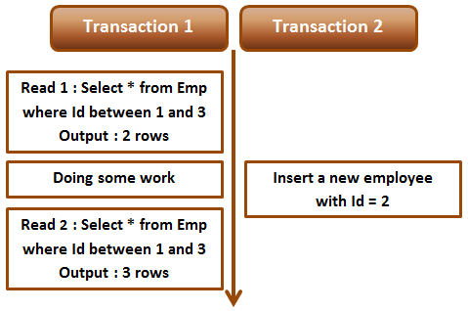
Phantom read problem
A transaction reads data twice and gets a different number of rows in the result set each time.
This happens when a second transaction inserts a new row or delete the existing row that matches the WHERE clause of the query executed by the first transaction.
Notes:
9.45

Slide 18
Concurrency control approaches
Pessimistic approach
A transaction is block if it may cause violation of the rules, until the possibility of violation disappears.
Blocking operations is typically involved with performance reduction.
Optimistic approach
Checking of whether a transaction meets the isolation and other integrity rules at the end.
Do not block any operations but abort a transaction if the desired rules are to be violated.
An aborted transaction is re-executed, which incurs an obvious overhead.

Slide 19
Concurrency control techniques
Locking
Controlling access to data by locks assigned to the data.
A transaction cannot access data if another transaction locks that data.
Timestamp ordering
Assigning timestamps to transactions and controlling or checking access to data by timestamp order.

Slide 20
Locking technique
When one transaction is accessing the database, a lock may deny access to other transactions to prevent incorrect results.
The lock prevents another transaction from modifying or reading data item.
The size of data item determines the granularity, which can be some parts of database or the whole database.
Database level
Table level
Record level
Field level

Slide 21
Locking types
Shared lock
If a transaction has a shared lock on a data item, it can read the item but not update it.
One or more transactions can hold shared locks simultaneously on the same item.
Shared lock can upgrade to exclusive lock.
Exclusive lock
If a transaction has an exclusive lock on a data item, it can both read and update.
If a transaction holds the exclusive lock on the item, no other transactions can read or update that data item.
Exclusive lock can downgrade to shared lock.

Slide 22
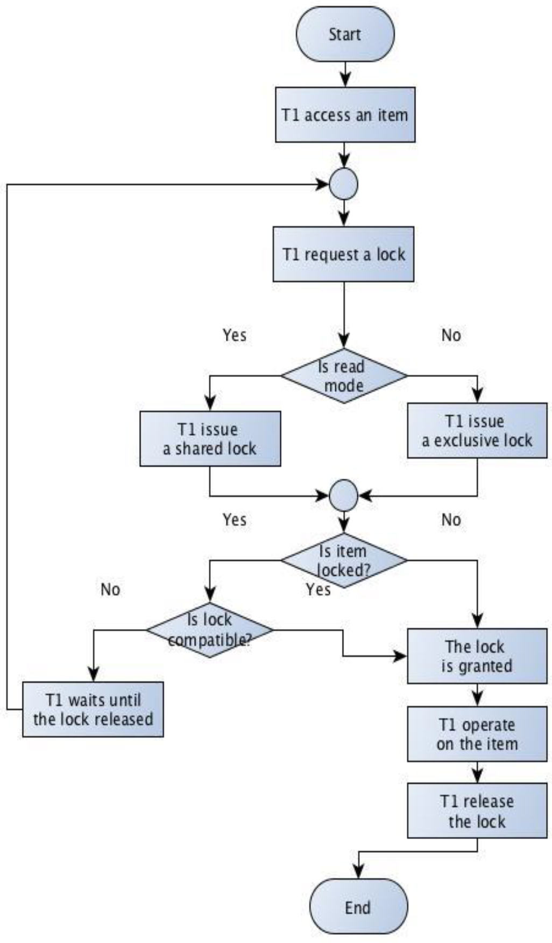
Locking flow

Slide 23
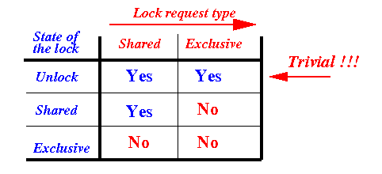
Lock compatible

Slide 24
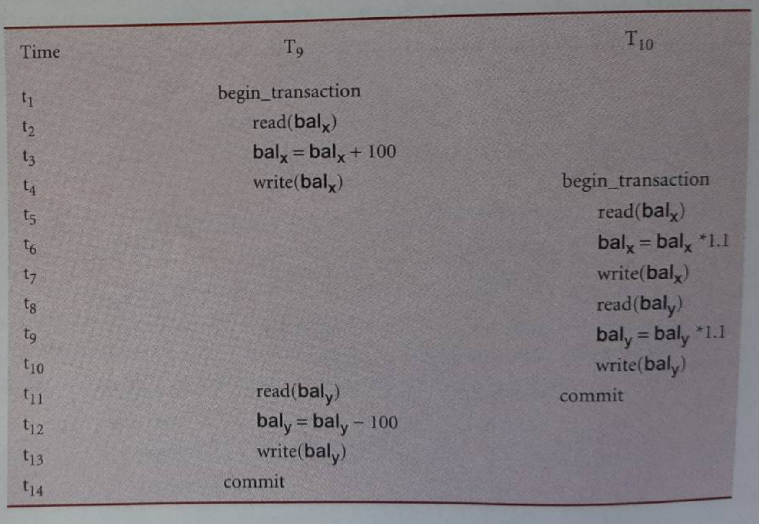
Example of locking

Slide 25
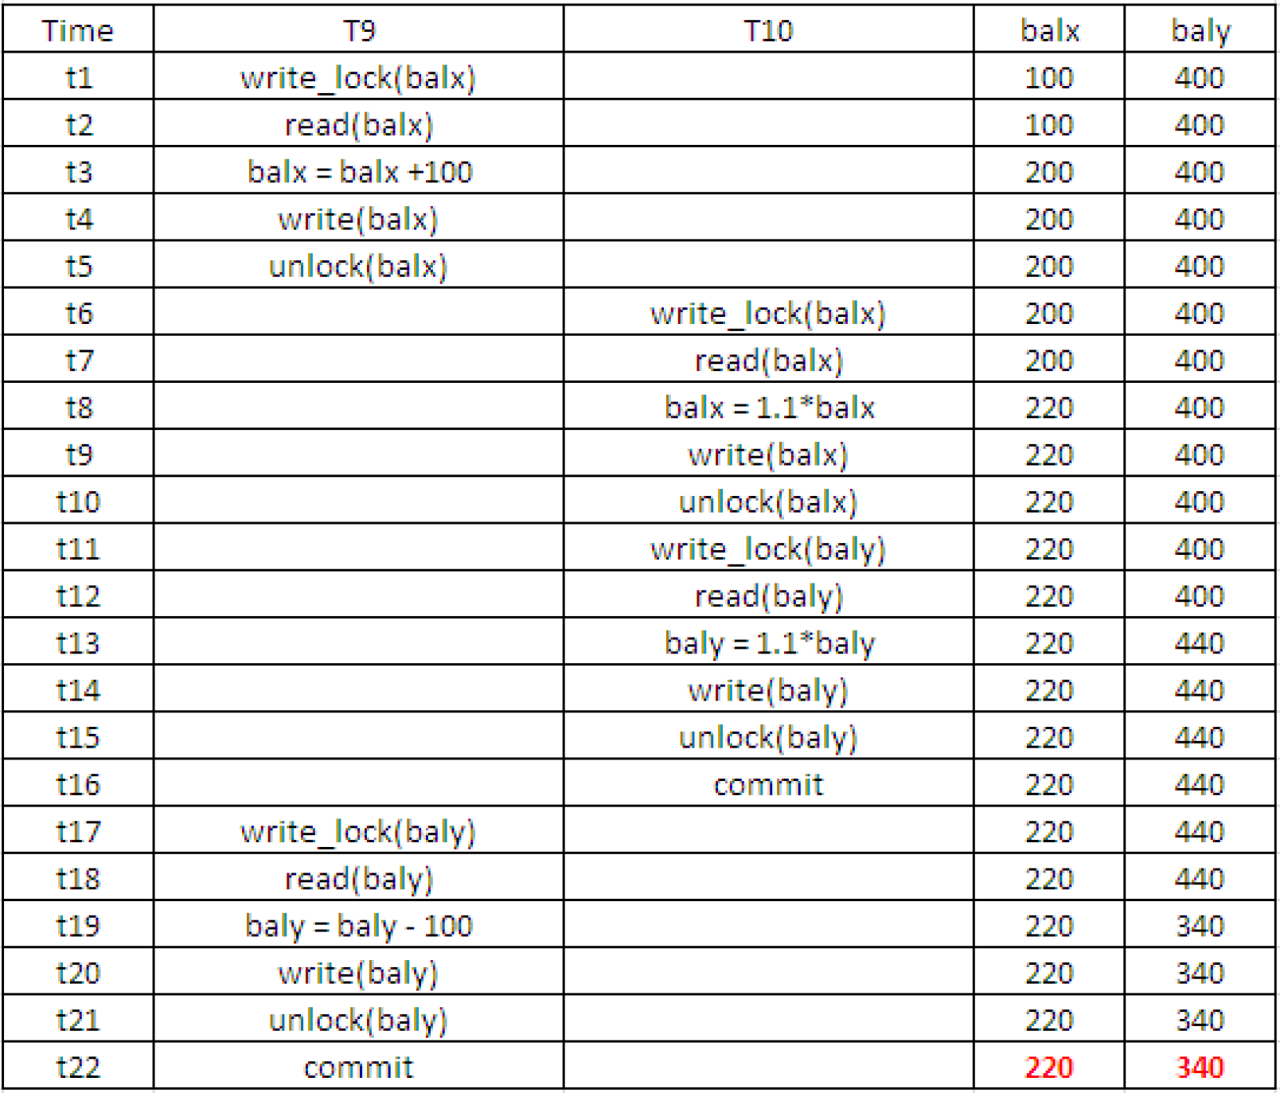
Transaction releases lock too soon.
T9 releases lock on balx then lock another data, baly.

Slide 26
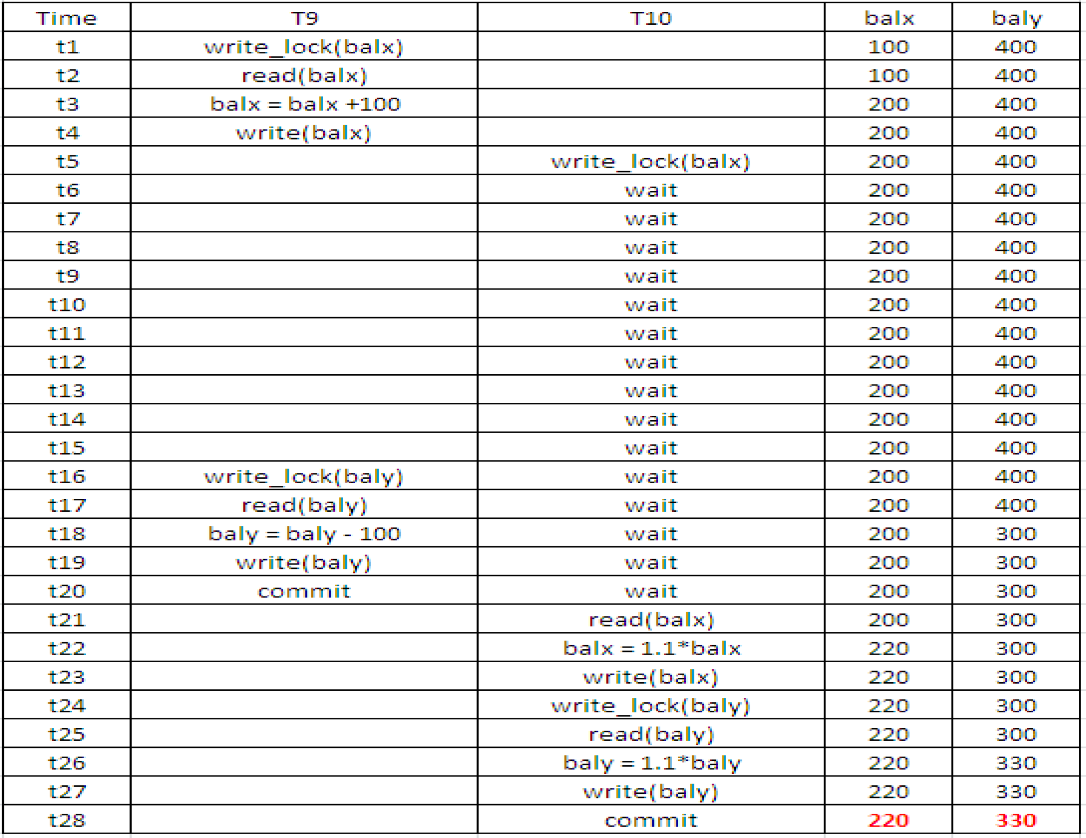
T9 executes before T10

Slide 27
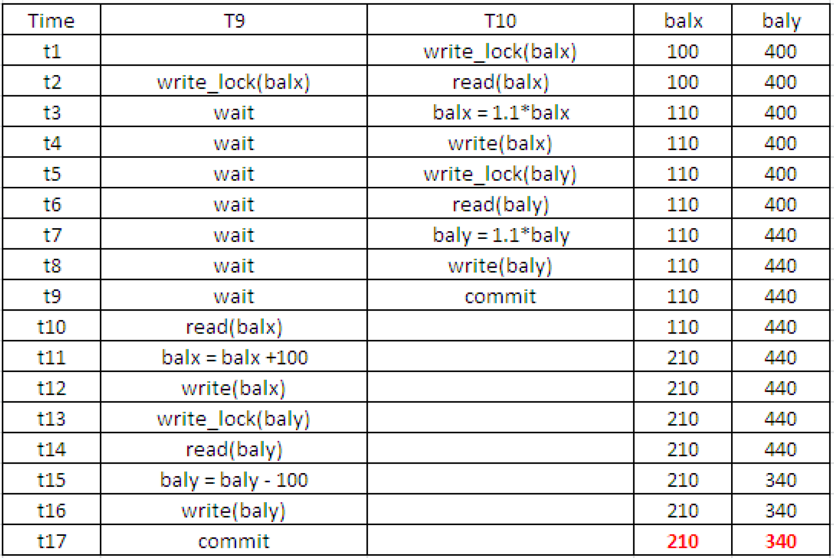
T10 executes before T9

Slide 28
Locking problem
A transaction release locks too soon. It release after executing read/write operations
It allows transactions to interfere with one another
This results in loss of isolation and atomicity.
Notes:
START 9:10

Slide 29
Two-phase locking
A transaction handles its locks in two distinct, consecutive phases during the execution
Growing phase (Expanding phase)
Transaction must acquire a lock before operating (read/write) on the item.
Locks are acquired and no locks are released (the number of locks can only increase).
All locks may not be obtained at the same time.
Transaction acquires some locks, does some processing, and goes on to acquire additional locks as needed
Shrinking phase (Contracting phase)
Locks are released and no locks are acquired.
Never acquire a lock after a lock has been released.

Slide 30
Preventing the lost update problem using 2PL

Slide 31
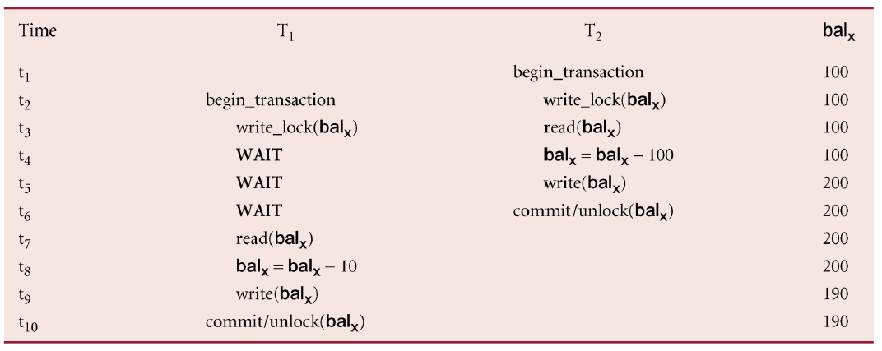
Preventing the lost update problem using 2PL

Slide 32
Preventing uncommitted dependency problem using 2PL

Slide 33
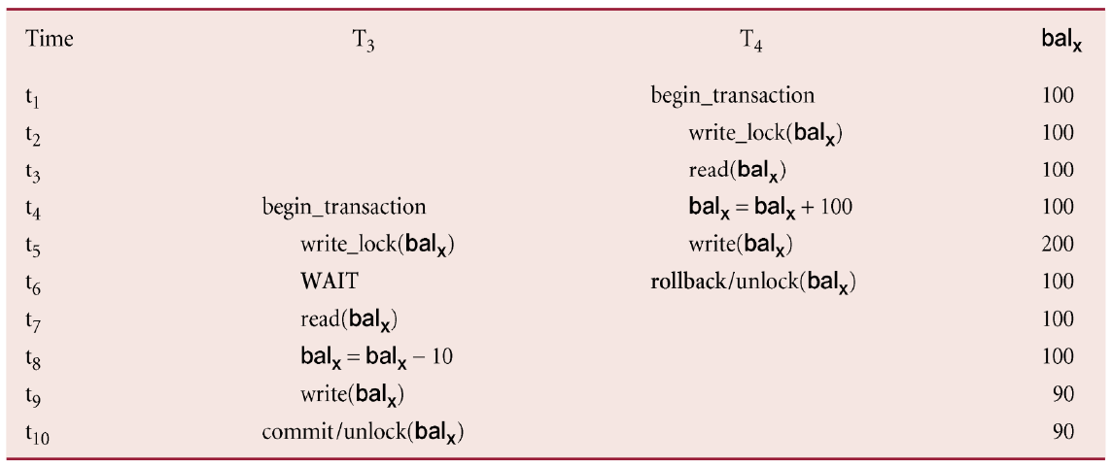
Preventing uncommitted dependency problem using 2PL

Slide 34
Preventing inconsistent analysis problem using 2PL

Slide 35
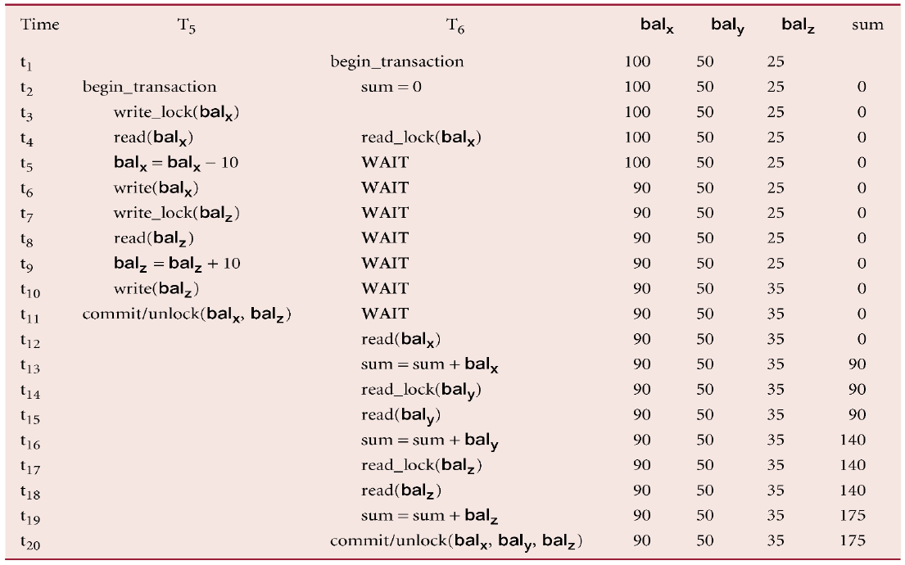
Preventing inconsistent analysis problem using 2PL

Slide 36
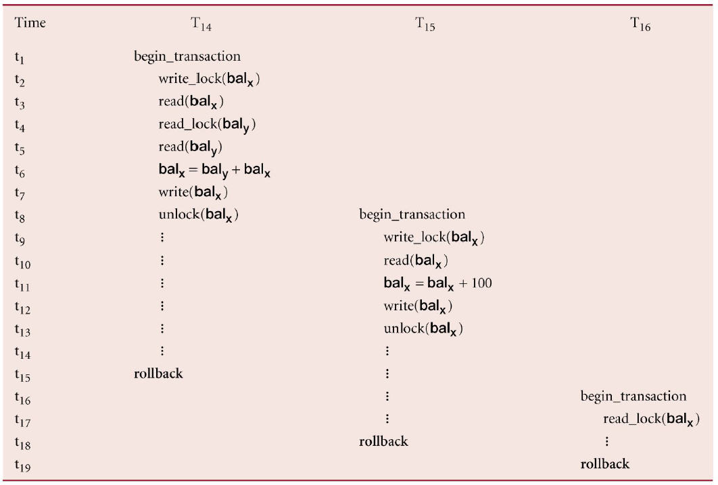
Cascading rollback
Notes:
What are disadvantages of cascading rollback?

Slide 37
Cascading rollback
Problems can occur with interpretation of when locks can be released.
Cascading rollback occurs when a transaction (Ti) causes a failure and a rollback must be performed.
Other transactions dependent on Ti’s actions must also be rollbacked due to Ti’s failure.

Slide 38
Preventing cascading rollback
Strict two-phase locking (S2PL)
Exclusive lock is released only after a transaction has ended (commit or rollback).
Shared lock is released regularly during phase 2.
Strong strict two-phase locking (SS2PL) or rigorous 2PL
Both exclusive lock and share lock are released after a transaction has ended (commit or rollback).

Slide 39
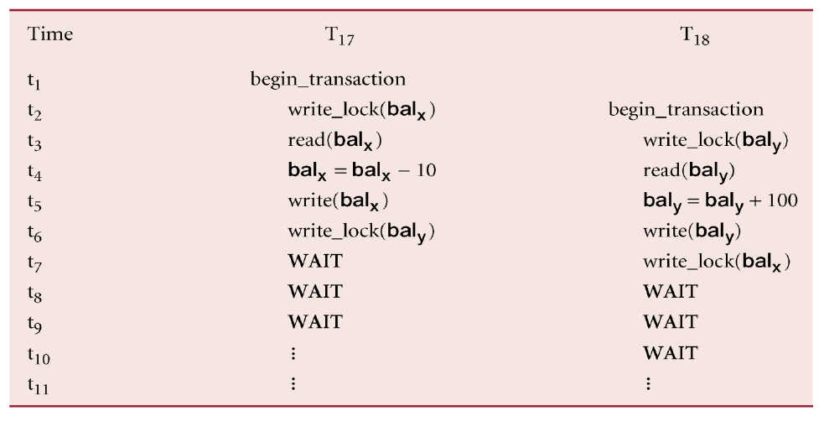
Deadlock problems

Slide 40
Deadlock problems
Two (or more) transactions wait for locks on items to be released that are held by the other transactions
This is a problem of using two-phase locking, which applies to all locking-based schemes
When deadlock occurs, the applications involved cannot resolve the problem.
The DBMS has to recognize the deadlock and break the deadlock in some way.
The only way to break deadlock is aborting one or more of transactions (requiring to undoing all the changes made by aborted transactions)

Slide 41
Livelock problem
A transaction is left in a wait state indefinitely.
DBMS is not in deadlock but a transaction unable to acquire a new locks.
Causes of livelock are:
The waiting algorithm is unfair and does not take account of the time that a transaction have been waiting.
No transaction priority, such as a first-come-first-served.
Notes:
10:00

Slide 42
Techniques for handling deadlock
Timeouts
Deadlock prevention
Deadlock detection

Slide 43
Timeouts
Simple approach is based on lock timeouts
A transaction that requests a lock will wait for a system-defined period of time
If the lock has been granted within this period, the lock request times out.
A transaction that is not deadlocked can be aborted.

Slide 44
Deadlock preventing
Conservative two-phase locking (C2PL)
C2PL obtains all the locks they need before the transactions begin.
A transaction that already holds some locks will not block waiting for other locks.
C2PL prevents deadlocks.
DBMS looks ahead to see if transaction would cause deadlock and never allows deadlock to occur.
Could order transactions using transaction timestamps:
Wait-Die algorithm
Wound-Wait algorithm

Slide 45
Deadlock prevention: Wait-Die
Only an older transaction can wait for younger one, If younger transaction requests lock held by older one younger one is aborted (dies) and restarted with same timestamp.
Example: assume that T22, T23, T24 have time-stamps 5, 10 and 15 respectively
If T22 requests a data item held by T23 then T22 will wait.
If T24 requests a data item held by T23 then T24 will be rolled back (die).

Slide 46
Deadlock Prevention :Wound-Wait
Only a younger transaction can wait for an older one. If older transaction requests lock held by younger one, younger one is aborted (wounded).
Example: assume that T22, T23, T24 have time-stamps 5, 10 and 15 respectively .
If T22 requests a data item held by T23 then data item will be stolen from T23 and T23 will be rolled back.
If T24 requests a data item held by T23 then T24 will wait.

Slide 47
Deadlock detection
DBMS allows deadlock to occur but recognizes it and breaks it.
Deadlock detection is handled by a wait-for graph (WFG)
Transaction Ti is dependent on Tj if Tj hold the lock on a data that Ti is waiting for.
If the WFG contains a cycle, the deadlock is detected.
Deadlock detection algorithm generates the WFG at regular intervals.
Small interval will add more overhead.
Large interval may not be detected for a long period.

Slide 48
Recovery from deadlock detection
Once a deadlock is detected, the DBMS needs to abort it and needs to be a way to recovery the aborted transactions.
Which transaction will be aborted?
How far to roll the transaction back?
Is there starving transaction?
The transactions that incur the minimum costs should be aborted
How long the transaction has been running?
How many data have been updated?
How many data will be updated?

Slide 49
Timestamping methods
Assumptions
Every timestamp value is unique and accurately represents an instant in time.
No two timestamps can be the same.
A higher-valued timestamp occurs later in time than a lower-valued timestamp.
Generating a timestamp
Use the value of the system's clock at the start of a transaction as the timestamp.
Use a thread-safe shared counter that is incremented at the start of a transaction as the timestamp.
A combination of the above two methods.

Slide 50
Timestamping methods
Symbols
The timestamp of transaction Ti is denoted as TS(Ti).
Read time-stamp of data-item X is denoted by R-timestamp(X).
Write time-stamp of data-item X is denoted by W-timestamp(X).
Transaction Ti will be aborted if
a transaction Ti issues a read(X) operation and TS(Ti) < W-timestamp(X)
a transaction Ti issues a write(X) operation and
TS(Ti) < R-timestamp(X)
TS(Ti) < W-timestamp(X)

Slide 51
Optimistic techniques
Based on assumption that conflict is rare and more efficient to let transactions proceed without delays to ensure serializability.
At commit, check is made to determine whether conflict has occurred.
If there is a conflict, transaction must be rolled back and restarted.
Potentially allows greater concurrency than traditional protocols.

Slide 52
Three phases for an optimistic concurrency control protocol
Read phase
A transaction reads the values of all data to local variables.
Updates are applied to a local copy.
Validation phase
Checks to ensure serializability is not violated.
Write phase
Updates data to the database.

Slide 53
Database recovery
Process of restoring database to a correct state in the event of a failure.
Transactions represent basic unit of recovery.
Recovery manager responsible for atomicity and durability.
The effects of committed transactions are permanently recorded in the database.

Slide 54
Causes of failure
Application software errors : Logic errors in program that is accessing the database causes the transactions to fail
System crashes : Hardware or software errors and stop working resulting in loss of data in the main memory
Media failures : Disk fails resulting in the loss of parts of storage.
Natural physical disasters : Uncontrol situations
Carelessness : Unintentional destruction of data
Sabotage : Intentional corruption
Notes:
RAM – volatile online
Disk – NV online
Tape – NV offline

Slide 55
Transactions and recovery
If a failure occurs, the committed transactions have to redo (rollforward).
If the transaction had not committed at the time of failure, the transactions have to undo (rollback).

Slide 56
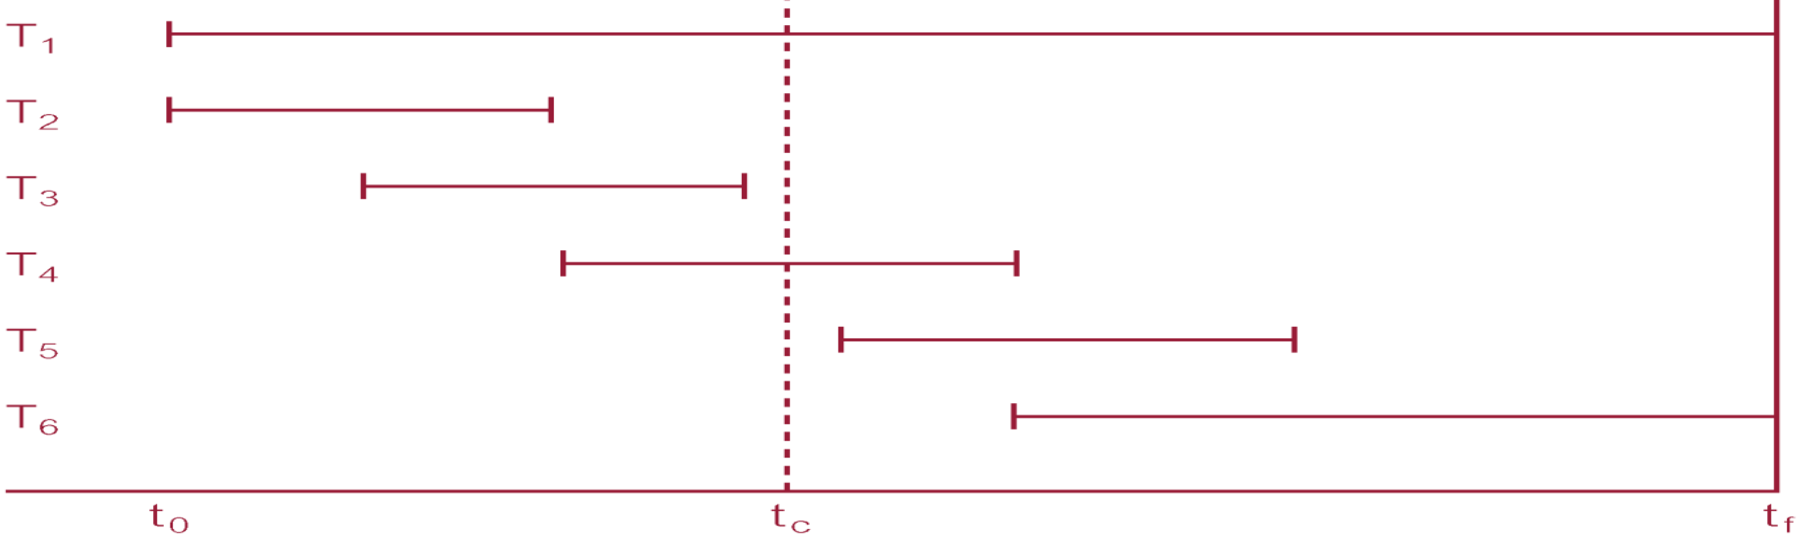
Example
Recovery manager has to undo T1 and T6.
Recovery manager has to redo T2, T3, T4 and T5.

Slide 57
Recovery facilities
Backup mechanism, which makes periodic backup copies of database (entire database or incremental backup).
Logging facilities, which keep track of current state of transactions and database changes .
Checkpoint facility, which enables updates to database in progress to be made permanent.
Recovery manager, which allows DBMS to restore the database to consistent state following a failure.

Slide 58
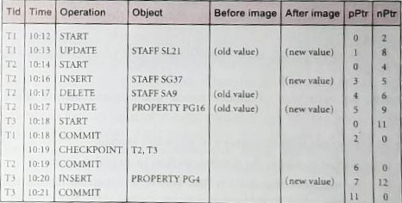
LOG file
Log file keeps track of database transactions
Contains information about all updates to database:
Transaction records.
Checkpoint records.

Slide 59
LOG file
The purposes of log file
Recovery
Performance monitoring and auditing
To recover quickly from failures, the log file be stored online on a fast direct-access storage device
Two or more separate copies of log file are maintained.

Slide 60
Checkpointing
Point of synchronization between database and log file. All buffers are force-written to secondary storage.
Checkpoint limits the amount of searching that we need to carry out on the log file
Checkpoint record is created containing identifiers of all active transactions.
Checkpoint is an inexpensive operation. It is possible to do frequently.

Slide 61
Checkpointing
When failure occurs, redo all transactions that committed since the checkpoint and undo all transactions active at time of crash.

Slide 62
Recovery techniques
System crashes and causes the inconsistency
Redo some transactions to updated data on disk.
The backup copy is not needed.
Database damages or disk crashes
Restore the last backup copy
Reapply the update operation using log file
Log file has not been damage. (Backing up log file separates from data file)

